Slide 1
ELEMENTARY PROBABILITY

Slide 2
Definition of some probability terms
Random experiment: is an experiment in which the outcome cannot be determined or predicted exactly in advance, i.e. it is the process of observing or measuring the outcome of a chance event.
Some of the characteristics of a random experiment are:
all the possible outcomes of the experiment can be specified in advance.
the experiment can be repeated indefinitely.
there is a sort of regularity in the outcomes observed in large repetitions of the experiment.

Slide 3
Sample point (outcome): The individual result of a random experiment.
Sample space: The set containing all possible sample points (out comes) of the random experiment.
The sample space is often called the universe and denoted by S.
Event: The collection of outcomes or simply a subset of the sample space. We denote events with capital letters, A, B, C, etc.

Slide 4
Example 5.1: If an experiment consists of flipping of a coin once, then
S = {H, T} where H means that the outcome of the toss is a head and T that it is a tail. A= {H} represents the event of head occurring.
Example 5.2: If an experiment consists of rolling a die once and observing the number on top, then the sample space is S = {1, 2, 3, 4, 5, 6} where the outcome i means that i appeared on the die, i = 1, 2, 3, 4, 5, 6. {1}, {2},{3},{4},{5} and {6}are elementary events i.e. events consisting of a single outcome. Let A represents the event of an odd number will occur, then A is simply the set containing 1, 3 and 5 i.e. A= {1, 3, 5}.

Slide 5
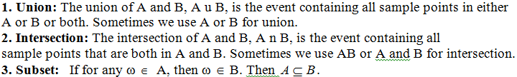

Slide 6
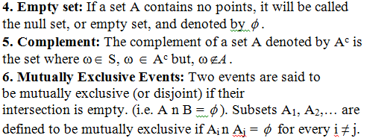

Slide 7
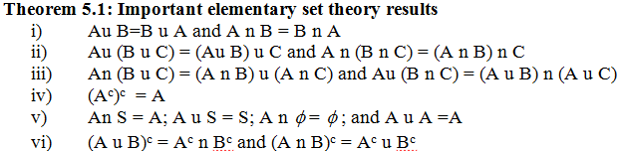

Slide 8
Counting rules
to assign probabilities for an event, we might need to enumerate the possible outcomes of a random experiment and need to know the number of possible outcomes favoring the event. The following principles will help us in determining the number of possible outcomes favoring a given event.

Slide 9
Addition principle
If a task can be accomplished by k distinct procedures where the i^{th} procedure has n_{i} alternatives, then the total number of ways of accomplishing the task equals n₁ + n₂+…+n_{k}.
Example 5.3: Suppose one wants to purchase a certain commodity and that this commodity is on sale in 5 government owned shops, 6 public shops and 10 private shops. How many alternatives are there for the person to purchase this commodity?
Solution: Total number of ways =5+6+10=21 ways

Slide 10
Multiplication principle
If a choice consists of k steps of which the first can be made in n₁ ways, for each of these the second can be made in n₂ ways,…, and for each of these the k^{th} can be made in n_{k} ways, then the whole choice can be made in n₁.n₂….n_{k} ways.
Example 5.4: If we can go from Addis Ababa to Rome in 2 ways and from Rome to Washington D.C. in 3 ways then the number of ways in which we can go from Addis Ababa to Rome to Washington D.C. is 2x3 ways or 6 ways. We may illustrate the situation by using a tree diagram below:

Slide 11
W
R
W
W
A
W
R
W
W

Slide 12
Example 5.5: If a test consists of 10 multiple choice questions, with each permitting 4 possible answers, how many ways are there in which a student gives his/her answers?
Solution: There are 10 steps required to complete the test.
First step: To give answer to question number one. He/she has 4 alternatives.
Second step: To give answer to question number two, he/she has 4 alternatives……
Last step: To give answer to last question, he/she has 4 alternatives.
Therefore, he/she has 4x4x4x…x4=4¹⁰ ways or1, 048, 576 ways of completing the exam. Note that there is only one way in which he/she can give correct answers to all questions and that there are 3¹⁰ ways in which all the answers will be incorrect.

Slide 13
Example 5.6: A manufactured item must pass through three control stations. At each station the item is inspected for a particular characteristic and marked accordingly. At the first station, three ratings are possible while at the last two stations four ratings are possible. Hence there are 48 ways in which the item may be marked.
Example 5.7: Suppose that car plate has three letters followed by three digits. How many possible car plates are there, if each plate begins with a H or an F?
2x 26x 26x 10x 10x 10 or 1, 352, 000 different plates.

Slide 14
If n is a positive integer, we define n!= n(n-1)(n-2)…1 and call it n-factorial and 0!=1.
Permutations
Suppose that we have n different objects. In how many ways, say _{n}P_{n}, may these objects be arranged (permuted)? For example, if we have objects a, b and c we can consider the following arrangements: abc, acb, bac, bca, cab, and cba. Thus the answer is 6. The following theorem gives general result on the number of such arrangements.

Slide 15
Theorem 5.4: Permutation
The number of permutations of n different objects is given by _{n}P_{n}= n!
A permutation of n objects, arranged in groups of size r, without repetition, and order being important is:

Slide 16
Example 5.8: Suppose that we have four letters a, b, c, d.
What is the number of possible arrangements of these letters taken all at a time?
What is the number of possible arrangements of these letters if we use only three of the letters at a time?

Slide 17
Solution:
Using (i) of theorem 5.4, we have 4! ways of arranging the 4 letters, i.e. we have 24 possible arrangements.
Using (ii) of theorem 5.4, we have ₄P₃ ways of arranging 3 letters taken from the four letters, i.e. we have 24 possible arrangements.

Slide 18
Example 5.9: In a class with 8 boys and 8 girls
In how many ways can the children line up if they alternate girl-boy-girl-boy-... ?
In how many ways can the children line up so that no two of the same sex are next to each other?
Solution:
The 8 girls can line-up in 8! ways, and likewise the 8 boys can line-up in 8! ways. For any single arrangement of the girls, all possible arrangements of the boys are possible, thus by multiplication principle we have 8!x 8! ways to arrange the children in girl-boy lines.
Now we must include the case of boy-girl. So we have 2x8!x 8! ways of arranging.

Slide 19
Example 5.10: If I have 5 different books on my shelf, in how many ways can I arrange these books? Solution: We can arrange the books in 5! different ways or 5x4x3x2x1 ways or 120 ways.
Remarks
i) The number of permutations of n distinct objects arranged in a circle is (n-1)!.
This is because we consider two permutations the same if one is a rotation of the other. For n objects arranged around a circle, there a n rotations that give the same permutation. Dividing n! by n gives (n - 1)!. The two circular permutations below are considered the same; their order is a, b, c, d, e.

Slide 20


Slide 21

ii) Permutations when not all objects are different
Given n objects of which n₁ are one kind, n₂ are another kind, …, n_{k} of another kind, then the total number of distinct permutations that can be made from these objects is

Slide 22
Example 5.11
How many "words" (text strings or distinct arrangements) can be made from the letters b,k,o,o?
How many permutations are there for the letters in the word banana?

Slide 23
If we label the two o’s as o₁ and o₂, and think of them as distinct, then the number of permutations is 4!. For each permutation there will be a matching permutation that switches the o’s, that is for o₁o₂bk there is the matching o₂o₁bk permutation. We can see then that if we divide the number of distinct permutations by two, we have a count of the number of permutations of the 4 letters where we do not distinguish between the two o’s. Therefore, there are distinct4!/2 text strings or 12 text strings.

Slide 24

If we think of all 6 letters as distinct, then we would have 6! permutations. As in the preceding example for the two n’s, we would need to divide 6! by 2. For the 3 a’s, we would have 6 counts for a single permutation. For instance, each of the following would be a single word if the a’s were not distinct. a₁a₂a₃bnn, a₁a₃a₂bnn, a₂a₁a₃bnn, a₂a₃a₁bnn, a₃a₁a₂bnn, and a₃a₂a₁bnn. Hence the number of distinct permutations of the word banana is
.

Slide 25
Combinations
Consider n different objects. This time we are concerned with counting the number of ways we may choose r out of these n objects without regard to order. For example, we have the objects a, b, c and d, and r=2; we wish to count ab, ac, ad, bc, bd, and cd. In other words, we do not count ab and ba since the same objects are involved and only the order differs.

Slide 26
There are many problems in which we are interested in determining the number of ways in which r objects can be selected from n distinct objects without regard to the order in which they are selected. Such selections are called combinations or r-sets. It may help to think of combinations as committees. The key here is without regard for order.

Slide 27


Slide 28
Example 5.12: How many different committees of 3 can be formed from Hawa, Segenet, Nigisty and Lensa?
Solution: The question can restated in terms of subsets from a set of 4 objects, how many subsets of 3 elements are there? In terms of combinations the question becomes, what is the number of combinations of 4 distinct objects taken 3 at a time? The list of committees:{H,S,N}, {H,S,L}, {H,N,L}, {S,N,L}.Therefore, we have ₄C₃ or 4 possible number of committees.

Slide 29
Example 5.13:
(i) A committee of 3 is to be formed from a group of 20 people. How many different committees are possible?
(ii) From a group of 5 men and 7 women, how many different committees consisting of 2 men and 3 women can be formed?

Slide 30
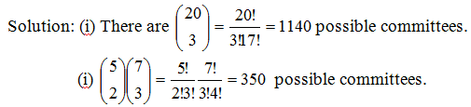

Slide 31
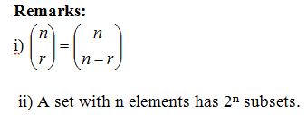

Slide 32
The Axioms of Probability
Probabilities are real numbers assigned to events (or subsets) of a sample space. We can think of the assignment of probabilities to events, or probability measure, as a function between the collection of subsets of the sample space and the real numbers.

Slide 33
Mathematically, a probability measure P for a random experiment is a real-valued function defined on the collection of events that satisfies the following axioms:
Axiom 1: The probability of an event is a nonnegative real number; that is, P(A) ≥ 0 for any subset A of S.
Axoim 2: P(S) = 1
Axiom 3: If A₁, A₂, A₃ ... is a finite or infinite sequence of mutually exclusive
events of S, then P(A₁ u A₂ u A₃ u ...) = P( A₁) + P( A₂) + P( A₃) + ...=

Slide 34
Suppose that we have a random experiment with sample space S and probability function P and A and B are events. Then we have the following results:
P( ) = 0
P(A^{c}) = 1 − P(A)
P(B n A^{c}) = P(B) − P(A n B)
If A subset of B then P(A) ≤ P(B).

Slide 35

The classical definition of probability
If an experiment can result in any one of N equally likely and mutually exclusive outcomes, and if n of these outcomes constitute the event A, then the probability of event A is

Slide 36
Consider the experiment of tossing a fair die. A fair die means that all six numbers are equally likely to appear. Calculate the probabilities of the following events:
A=One will occur ={1}
B=Even number will occur ={2, 4, 6}
C=Odd number will occur ={1, 3, 5}
D=A number less than 3 will occur ={1,2}

Slide 37
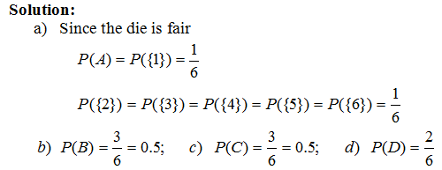

Slide 38
Example 5.15: Suppose that we toss two coins, and assume that each of the four outcomes in the sample space S = {(H,H),(H, T ), (T ,H), (T , T )} are equally likely and hence has probability ¼. Let A = {(H, H),(H, T )} and B = {(H,H), (T ,H)} that is, A is the event that the first coin falls heads, and B is the event that the second coin falls heads. Then, calculate the probabilities of A, B, A^{c}, B^{c}, and S^{c}. The event that none of the outcomes will occur is the same as S^{c}.

Slide 39
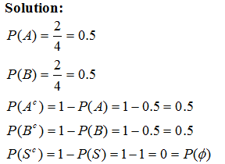

Slide 40
Example 5.16: From a group of 5 men and 7 women, it is required to form a committee of 5 persons. If the selection is made randomly, then
What is the probability that 2 men and 3 women will be in the committee?
What is the probability that all members of the committee will be men?
What is the probability that at least three members will be women?

Slide 41
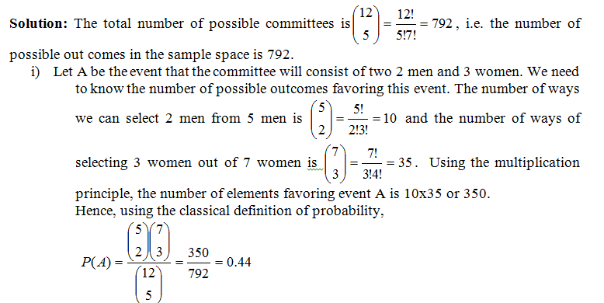

Slide 42
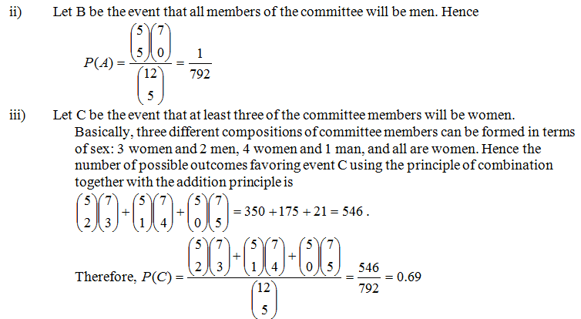

Slide 43
Relative Frequency Definition of probability
If an experiment is repeated a large number, n, of times and the event A is observed n_{A} times, the probability of A is P(A) ≈ n_{A}/n.
The above definition of probability is based on empirical data accumulated through time or based on observations made from repeated experiments for a large number of times.

Slide 44
Some probability rules
If A and B , then P(A u B) = P(A) + P(B) − P(A n B).
Example 5.17: Consider the experiment of tossing a fair die. Let
A = Even number occurring = {2,4,6}
B = A number greater than 2 occurring ={3, 4, 5, 6}
C = Odd number occurring ={1, 3, 5}
What is the probability that A and B will occur?
What is the probability that A or B will occur?

Slide 45
Solution: We use the concept of set theory to help us solve probability questions very easily and vein diagrams are useful tools to depict the relations between events within the sample space. The shaded region on Fig 1. shows the event that both A and B will occur.
A and B ≡ AnB ={4,6} Thus P(AnB)=2/6.
A or B ≡ AUB ={2,3,4,5,6} AnB={4,6} Hence,

Slide 46
Example 5.18: Sixty percent of the families in a certain community own their own car, thirty percent own their own home, and twenty percent own both their own car and their own home. If a family is randomly chosen,
what is the probability that this family do not have a car?
what is the probability that this family owns a car or a house?
what is the probability that this family owns a car or a house but not both?
what is the probability that this family owns only a house?
what is the probability that this family neither owns a car nor a house?

Slide 47
Solution: Let A represents that the family owns a car and B represents that the family owns a house. Given information: P(A)=0.6,P(B)=0.3, and P(AnB)=0.2.
Required: P(A^{c}) = ? P(A^{c})=1-P(A) = 1-0.6 = 0.4
Required: P(AUB) = ? P(AUB) = P(A)+P(B)-P(AnB) = 0.6+0.3-0.2 = 0.7
Required: P((AnB^{c})U(A^{c}nB)) = ? P((AnB^{c})U(A^{c}nB)) = P(AnB^{c})+P(A^{c}nB) = [P(A)-P(AnB)]+[P(B)-P(AnB)] = [0.6-0.2]+[0.3-0.2]=0.5

Slide 48
Required: P(A^{c}nB) =? P(A^{c}nB) = P(B)-P(AnB) = 0.3-0.2 = 0.1
Required: P(A^{c}nB^{c}) = ? P(A^{c}nB^{c}) = P((AUB)^{c}) = 1-P(AUB) = 1-0.7 = 0.3

Slide 49
We can represent various events by an informative diagram called vein diagram. If properly and correctly drawn, a vein diagram helps to calculate probabilities of events easily. The figure below shows various events represented by shaded regions. Note that the rectangle in each figure represents the sample space.

Slide 50
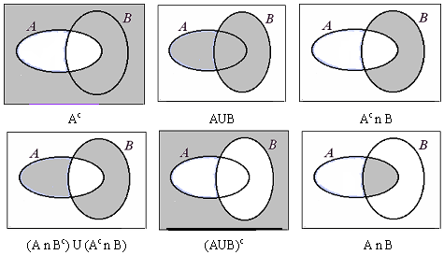

Slide 51
Conditional probability and independence
Conditional Probability
Conditional probability provides us with a way to reason about the outcome of an experiment, based on partial information. Here are some examples of situations we may have in our mind:
(a) What is the probability that a person will be HIV-Positive given he has tuberculosis?
(d) A spot shows up on a radar screen. How likely is it that it corresponds to an aircraft?

Slide 52

If P(B) > 0, the conditional probability of A given B, denoted by P(A|B), is

Slide 53
Example 5.19: Suppose cards numbered one through ten are placed in a hat, mixed up, and then one of the cards is drawn at random. If we are told that the number on the drawn card is at least five, then what is the conditional probability that it is ten?
Solution: Let A denote the event that the number on the drawn card is ten, and B be the event that it is at least five. The desired probability is P(A|B).

Slide 55
Example 5.20: A family has two children. What is the conditional probability that both are boys given that at least one of them is a boy? Assume that the sample space S is given by S = {(b, b), (b, g), (g, b), (g, g)}, and all outcomes are equally likely. (b, g) means, for instance, that the older child is a boy and the younger child is a girl.

Slide 56

Solution: Letting A denote the event that both children are boys, and B the event that at least one of them is a boy, then the desired probability is given by

Slide 57
Law of Multiplication
The defining equation for conditional probability may also be written as:
P(AnB) = P(B) P(A|B)
This formula is useful when the information given to us in a problem is P(B) and P(A|B) and we are asked to find P(AnB). An example illustrates the use of this formula. Suppose that 5 good fuses and two defective ones have been mixed up. To find the defective fuses, we test them one-by-one, at random and without replacement. What is the probability that we are lucky and find both of the defective fuses in the first two tests?

Slide 58

Example 5.21: Suppose an urn contains seven black balls and five white balls. We draw two balls from the urn without replacement. Assuming that each ball in the urn is equally likely to be drawn, what is the probability that both drawn balls are black?
Solution: Let A and B denote, respectively, the events that the first and second balls drawn are black. Now, given that the first ball selected is black, there are six remaining black balls and five white balls, and so P(B|A) = 6/11. As P(A) is clearly 7/12 , our desired probability is

Slide 59
Independence
We have introduced the conditional probability P(A|B) to capture the partial information that event B provides about event A. An interesting and important special case arises when the occurrence of B provides no information and does not alter the probability that A has occurred, i.e., P(A|B) = P(A). When the above equality holds, we say that A is independent of B. Note that by the definition P(A|B) = P(A ∩ B)/P(B), this is equivalent to P(A ∩ B) = P(A)P(B).

Slide 60
Independence
Two events A and B are said to independent if P(A ∩ B) = P(A)P(B). If in addition, P(B) > 0, independence is equivalent to the condition P(A|B) = P(A).

